Slide 1
Impact of War on Art and Science
SSWH17 The student will be able to identify the major political and economic factors that shaped world societies between World War I and World War II.
a. Examine the impact of the war on science, art, and social thinking by identifying the cultural significance of Sigmund Freud, Albert Einstein, and Picasso.

Slide 2
A New Physics
Before 1914, many still believed in the values of the Scientific Revolution and Enlightenment
Newton’s machine concept of the universe was still accepted
Marie Curie discovered that radium gave off energy or radiation. As a result, they realized atoms were not simply hard materials.
This discovery along with others would change the traditional views of the world

Slide 3
Albert Einstein
A German born scientist working in Switzerland who provided a new view of the world at the beginning of the 20th century
1905 published his theory of relativity stating that space & time are not absolute
Promoted the idea that matter is another form of energy
Led to the Atomic Age
To some, this meant a world without certainty

Slide 4
Sigmund Freud & Psychoanalysis
Sigmund Freud was a doctor from Vienna
Proposed a series of theories that raised questions about the nature of the human mind
1900 published Interpretations of Dreams
According to Freud, human behavior was strongly determined by past experiences & internal forces of which people were largely unaware
Psychoanalysis- method by which a therapist and patient could probe deeply into the patient’s memory
If the patient’s mind could be made aware of the unconscious and repressed contents, the patient could be healed
Developed into a major profession

Slide 5
Culture of Modernity
Changes between 1870 and 1914 in art & literature; rebelling against traditional literary and artistic styles that had dominated since the Renaissance
This period was one of the most productive in art history.
By late 19th century, artists were seeking new forms of expression to reflect changing values

Slide 6
New Styles Developed
Impressionism- began in France in 1870’s; Artists include Claude Monet, Auguste Renoir, and Berthe Morisot
Postimpressionism- began in the 1880’s. Vincent Van Gogh, a postimpressionist, believed artists should paint what they feel
Beginning of 20th century, artists are seeking meaning in individual expression
1910, abstract expressionism began. One of these artists was Wasilly Kandinsky

Slide 8
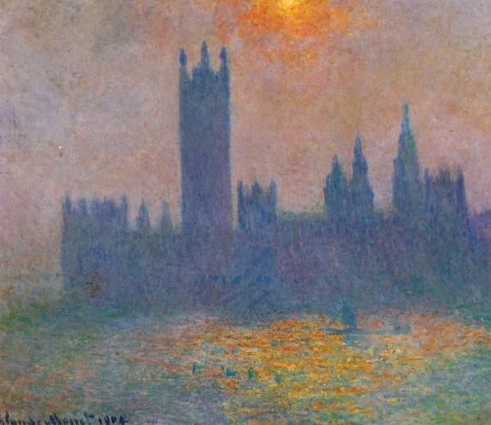

Slide 9
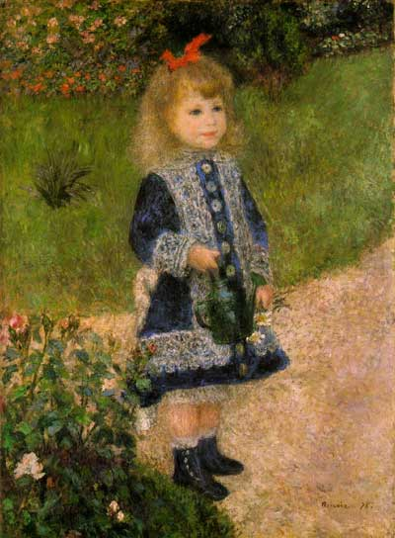

Slide 10
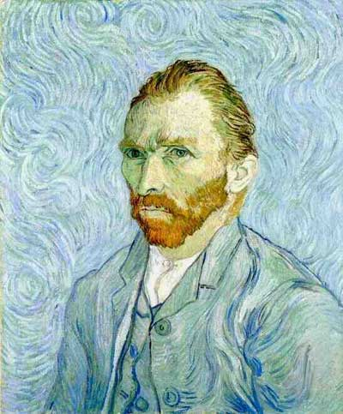

Slide 11
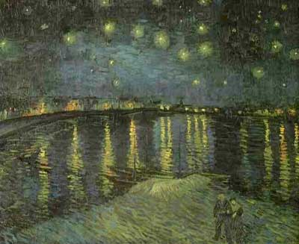

Slide 12
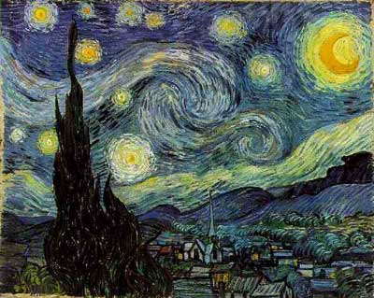

Slide 13
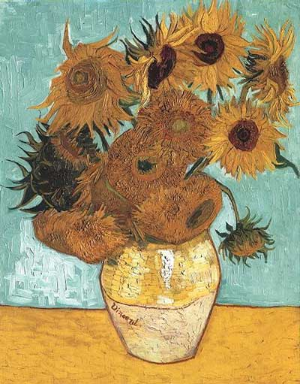

Slide 14
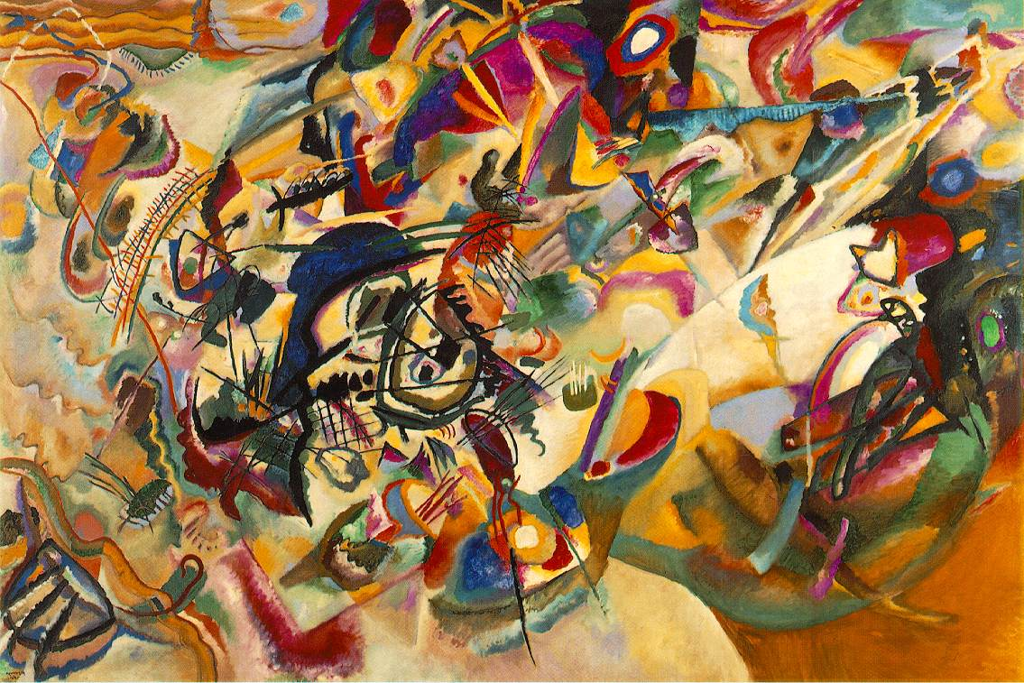

Slide 15
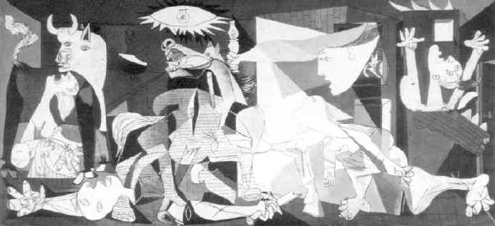
Pablo Picasso
By 1905, Picasso was starting his career
Created a new style, cubism, that used geometric designs to recreate reality
Attempted to view human forms from many sides

Slide 17
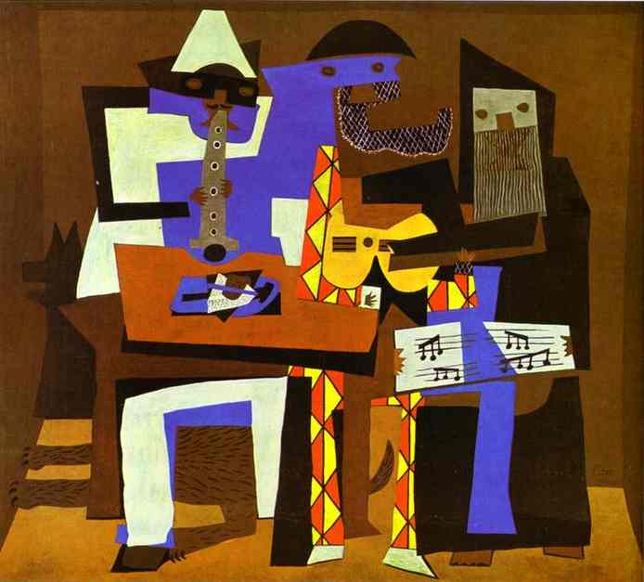

Slide 18
Architecture
New style developed called functionalism
Believed that buildings should be useful, all unnecessary ornamentation stripped away
Led by Louis H. Sullivan of the Chicago School
His most successful student would be one of the most well known architects of the century- Frank Lloyd Wright

Slide 20
