Slide 1
Classical Mediterranean
For each source, see slide notes for additional information
Notes:
Slide Background: By http://www.geographicus.com/mm5/cartographers/homannheirs.txt [Public domain], via Wikimedia Commons
This is one of the Homann Heirs finest and most appealing maps of the ancient Greek World. Map centers on Greece but includes the entirety of the eastern Mediterranean and North Africa. Also includes the Black Sea as far as the Crimea and the sea of Azov. Extends north as far as Sarmatia and Pannonia. Includes Italy, Sicily, Corsica and Sardinia. Upper left quadrant features a decorative title cartouche adorned with the rectos and versos of 12 ancient Greek coins with explanatory numbered references outside the top border of the map. Show the important Greek provinces and colonies through the Mediterranean, especially in modern day turkey and in the Italian peninsula. Includes nautical military and trade routes. This map was drawn by Joanes Christoph Harenberg for inclusion the 1752 Homann Heirs Maior Atlas Scholasticus ex Triginta Sex Generalibus et Specialibus…. Most early Homann atlases were “made to order” or compiled of individual maps at the request of the buyer. However, this rare atlas, composed of 37 maps and charts, was issued as a “suggested collection” of essential Homann Heirs maps. A fine copy of an important map.

Slide 2
Ancient Greek World
Notes:
Share map.

Slide 3
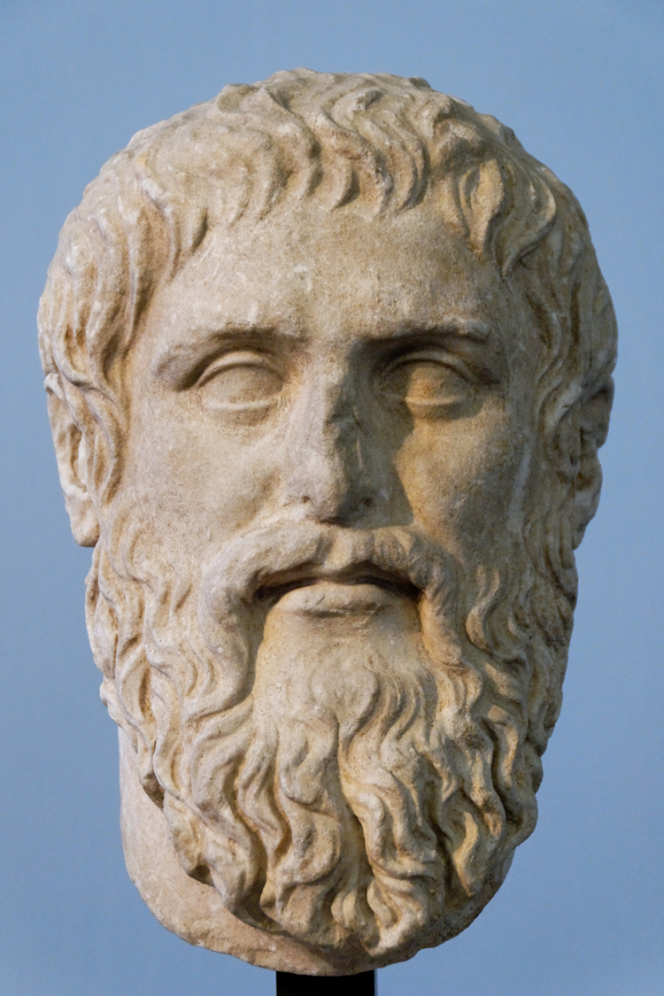
Plato
Notes:
© Marie-Lan Nguyen / Wikimedia Commons, via Wikimedia Commons
Plato. Luni marble, copy of the portrait made by Silanion ca. 370 BC for the Academia in Athens. From the sacred area in Largo Argentina.

Slide 4
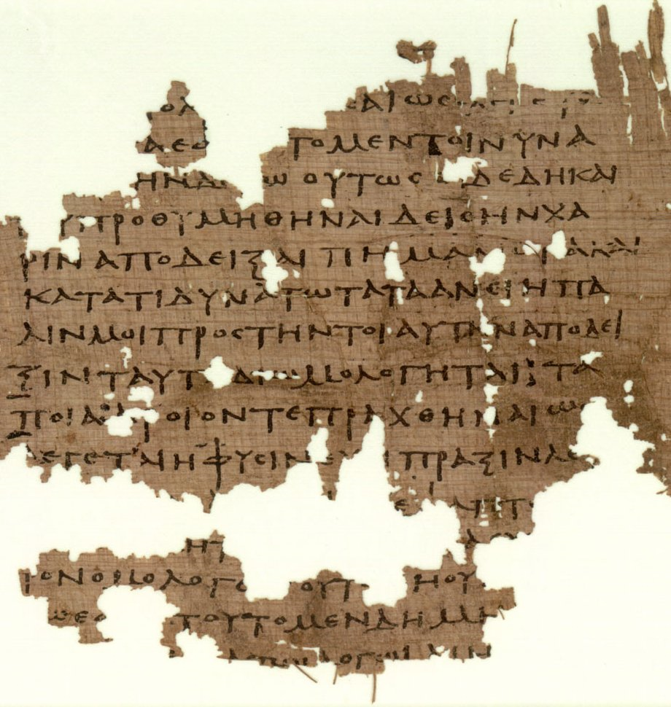
Notes:
By Platon (http://www.papyrology.ox.ac.uk/POxy/) [Public domain], via Wikimedia Commons
Parts of P.Oxy. LII 3679, 3rd century, containing fragments of Plato's Republic.

Slide 5
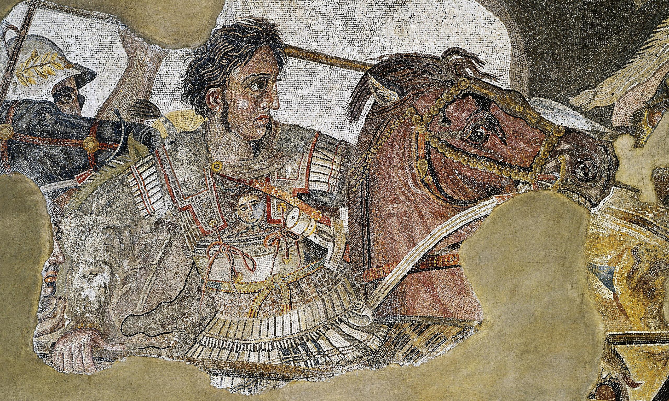
Alexander the Great
Notes:
See page for author [Public domain], via Wikimedia Commons
The detail of the Alexander Mosaic showing Alexander the Great.

Slide 6
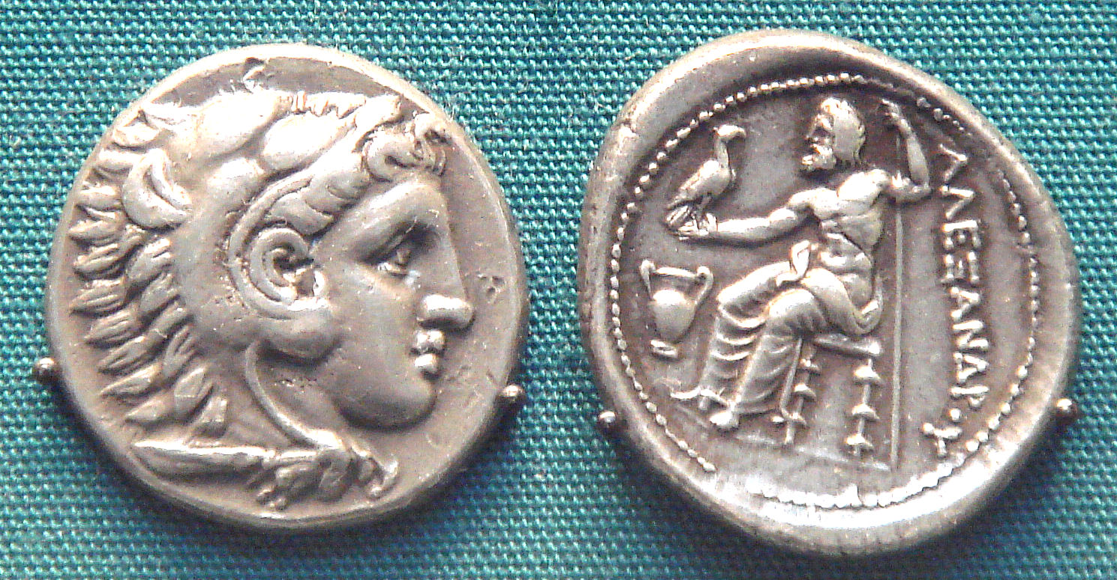
Notes:
I, PHGCOM [GFDL (http://www.gnu.org/copyleft/fdl.html), CC-BY-SA-3.0 (http://creativecommons.org/licenses/by-sa/3.0/) or CC BY-SA 2.5-2.0-1.0 (http://creativecommons.org/licenses/by-sa/2.5-2.0-1.0)], via Wikimedia Commons
Silver coin of Alexander wearing the lion scalp of Herakles, British Museum

Slide 7
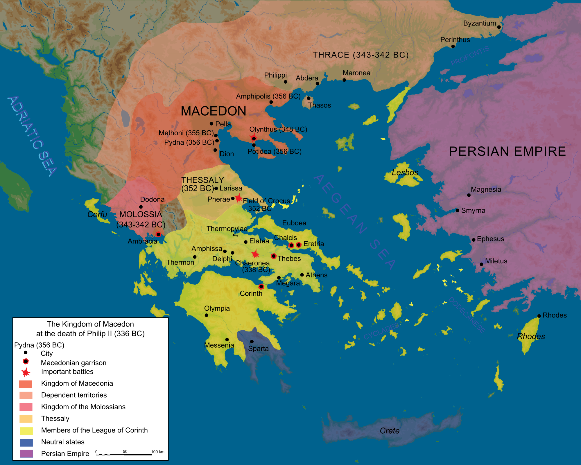
Notes:
By Map_Macedonia_336_BC-es.svg: Marsyas (French original); Kordas (Spanish translation) derivative work: MinisterForBadTimes [CC BY-SA 2.5 (http://creativecommons.org/licenses/by-sa/2.5), CC-BY-SA-3.0 (http://creativecommons.org/licenses/by-sa/3.0/) or GFDL (http://www.gnu.org/copyleft/fdl.html)], via Wikimedia Commons
The Kingdom of Macedon in 336 BC.

Slide 8
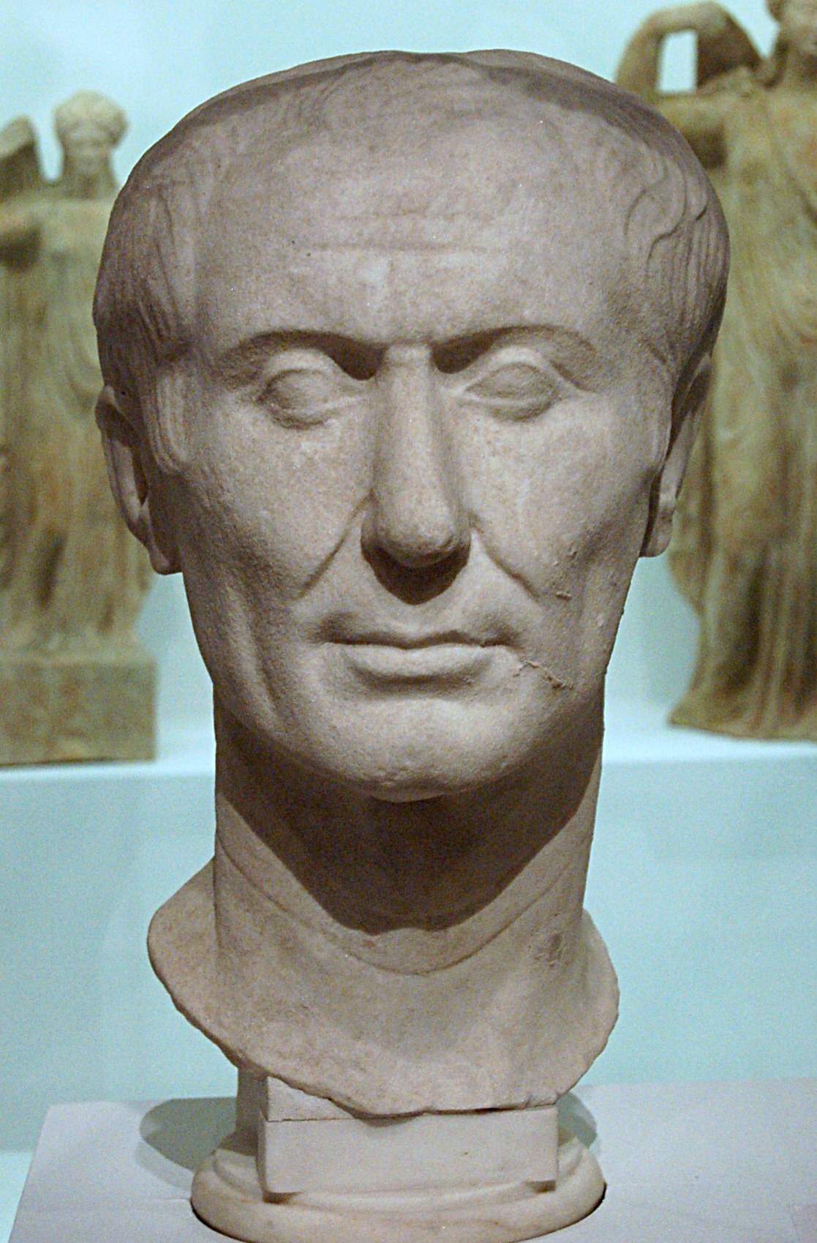
Julius Caesar
Notes:
By Gautier Poupeau from Paris, France (César) [CC BY 2.0 (http://creativecommons.org/licenses/by/2.0)], via Wikimedia Commons
The Tusculum portrait, perhaps the only surviving sculpture of Caesar made during his lifetime

Slide 9
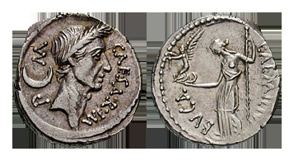
Notes:
Classical Numismatic Group, Inc. http://www.cngcoins.com [GFDL (http://www.gnu.org/copyleft/fdl.html), CC-BY-SA-3.0 (http://creativecommons.org/licenses/by-sa/3.0/) or CC BY-SA 2.5 (http://creativecommons.org/licenses/by-sa/2.5)], via Wikimedia Commons
A denarius depicting Julius Caesar, dated February–March 44 BC; the goddess Venus is shown on the reverse, holding Victoria and a scepter.

Slide 10
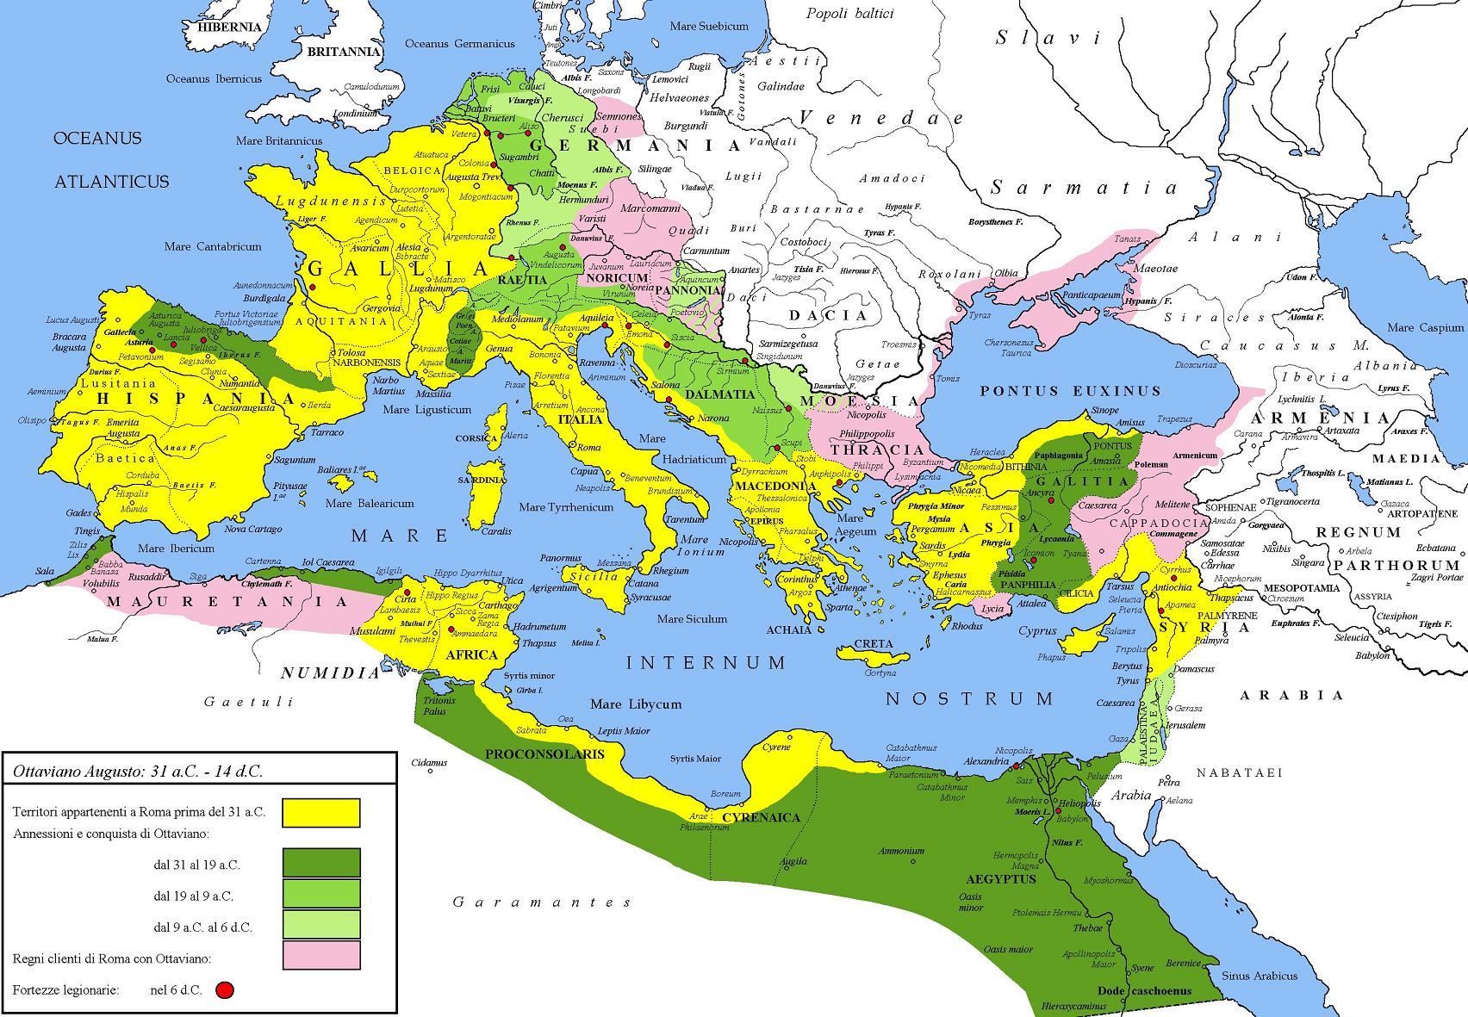
Augustus Caesar
Notes:
By Cristiano64 (Lavoro proprio, self-made) [GFDL (http://www.gnu.org/copyleft/fdl.html) or CC-BY-SA-3.0 (http://creativecommons.org/licenses/by-sa/3.0/)], via Wikimedia Commons
Extent of the Roman Empire under Augustus. The yellow legend represents the extent of the Republic in 31 BC, the shades of green represent gradually conquered territories under the reign of Augustus, and pink areas on the map represent client states; however, areas under Roman control shown here were subject to change even during Augustus' reign, especially in Germania.

