Slide 1
World History Unit 4 Source Set: Islamic World
Notes:
By ~crystalina~ (Flickr) [CC BY 2.0 (http://creativecommons.org/licenses/by/2.0)], via Wikimedia Commons
https://upload.wikimedia.org/wikipedia/commons/1/1e/Koran_cover_calligraphy.PNG

Slide 2
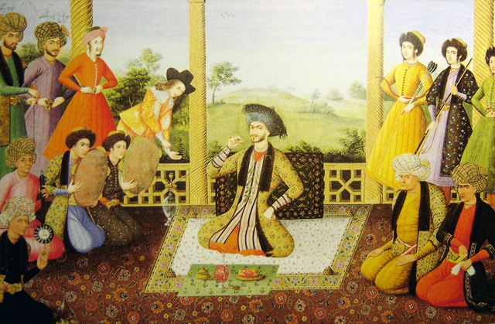
Notes:
Shah Suleiman I and his courtiers, Isfahan, 1670. Painter is Ali Qoli Jabbador, and is kept at The St. Petersburg Institute of Oriental Studies in Russia, ever since it was acquired by Tsar Nicholas II. Note the two Georgian figures with their names at the top left.
https://upload.wikimedia.org/wikipedia/commons/2/2c/Shah_soleiman_safavi.jpg
By Ali Qoli Jabbador [GFDL (http://www.gnu.org/copyleft/fdl.html) or CC-BY-SA-3.0 (http://creativecommons.org/licenses/by-sa/3.0/)], via Wikimedia Commons

Slide 3
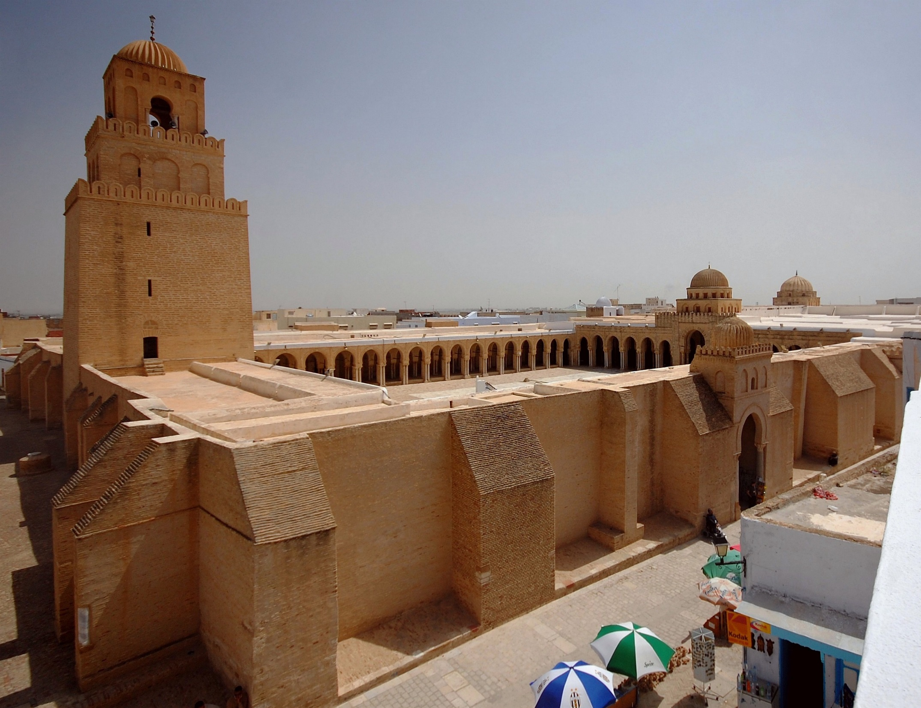
Notes:
The Mosque of Uqba (Great Mosque of Kairouan), founded by the Umayyad general Uqba Ibn Nafi in 670 CE, is the oldest and most prestigious mosque in the Muslim West; its present form dates from the 9th century, Kairouan, Tunisia.
By weetoon66 (Flickr: Great mosque - Kairouan - Grande mosquée) [CC BY-SA 2.0 (http://creativecommons.org/licenses/by-sa/2.0)], via Wikimedia Commons
https://upload.wikimedia.org/wikipedia/commons/3/31/Grande_Mosqu%C3%A9e_de_Kairouan%2C_vue_d%27ensemble.jpg

Slide 4
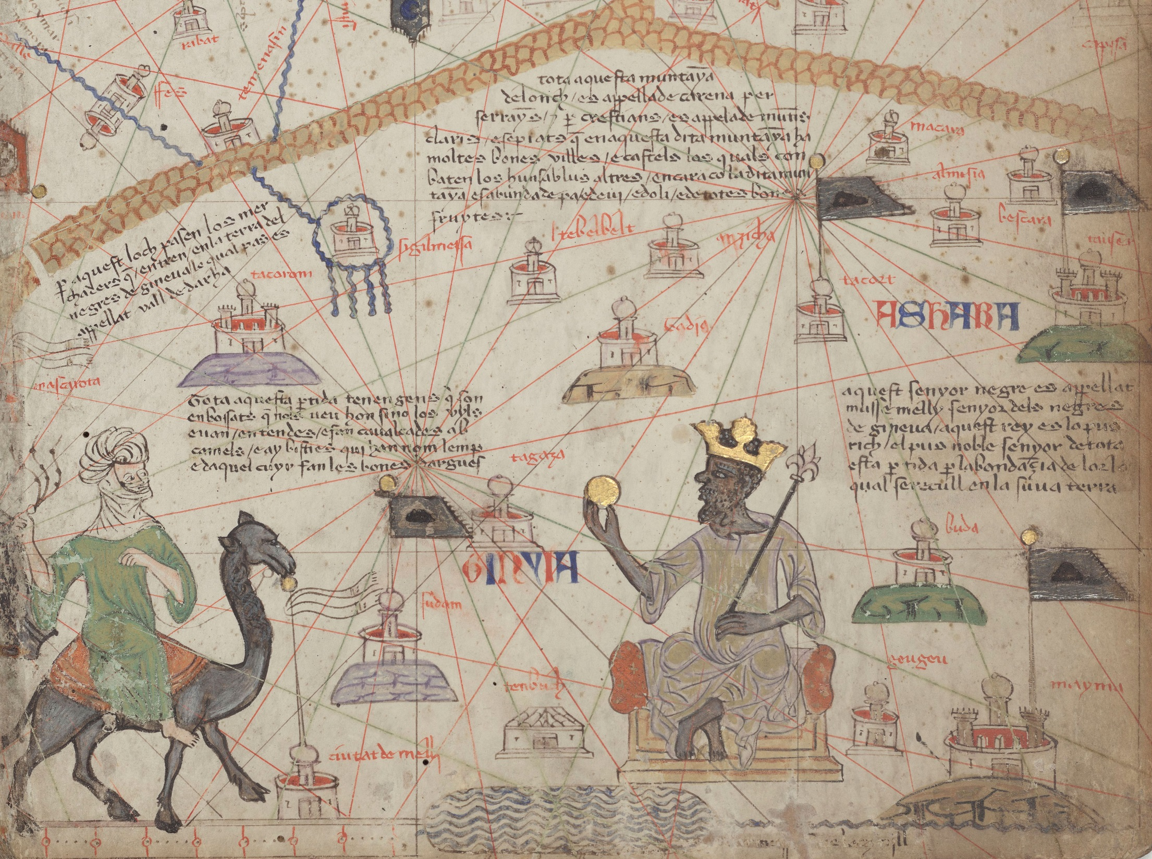
Notes:
By attributed to Abraham Cresques [Public domain], via Wikimedia Commons
https://upload.wikimedia.org/wikipedia/commons/7/7a/Catalan_Atlas_BNF_Sheet_6_Western_Sahara.jpg
Sheet 6 out of 12. This is the lower portion of the sheet and shows the Western Sahara. The Atlas Mountains are at the top and the River Niger at the bottom. Mansa Musa is shown sitting on a throne and holding a gold coin.

Slide 5
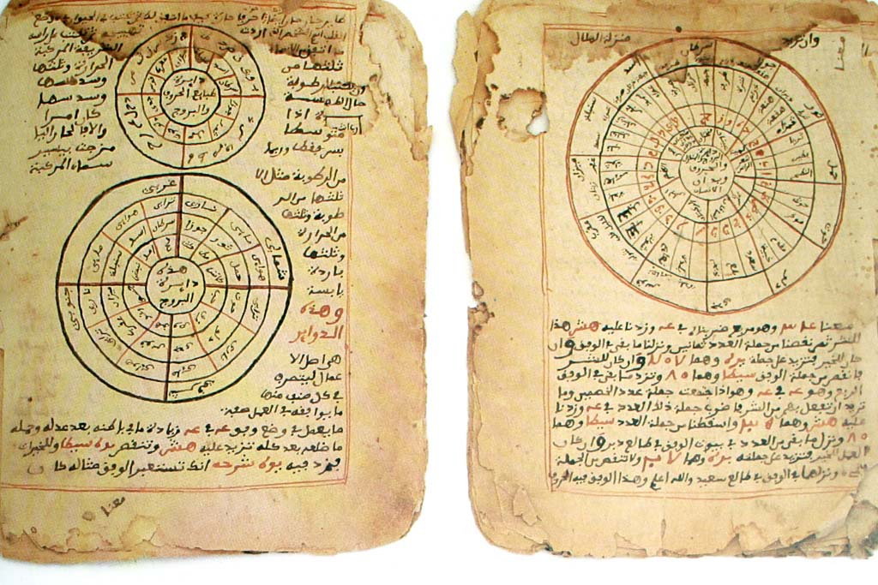
Notes:
The pages above are from Timbuktu Manuscripts written in Sudani script (a form of Arabic) from the Mali Empire showing established knowledge of astronomy and mathematics. Today there are close to a million of these manuscripts found in Timbuktu alone.
See page for author [Public domain], via Wikimedia Commons
https://upload.wikimedia.org/wikipedia/commons/4/4f/Timbuktu-manuscripts-astronomy-mathematics.jpg

Slide 6
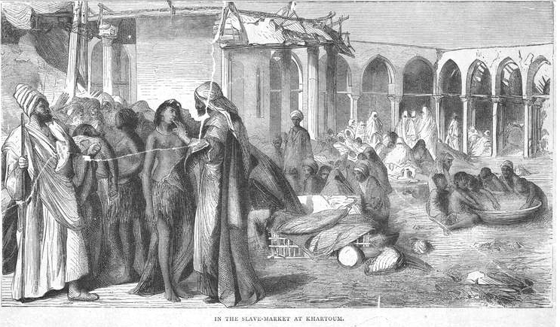
Notes:
Art and Picture Collection, The New York Public Library. "In The Slave-Market At Khartoum." The New York Public Library Digital Collections. 18--?. http://digitalcollections.nypl.org/items/510d47e1-3378-a3d9-e040-e00a18064a99

Slide 7
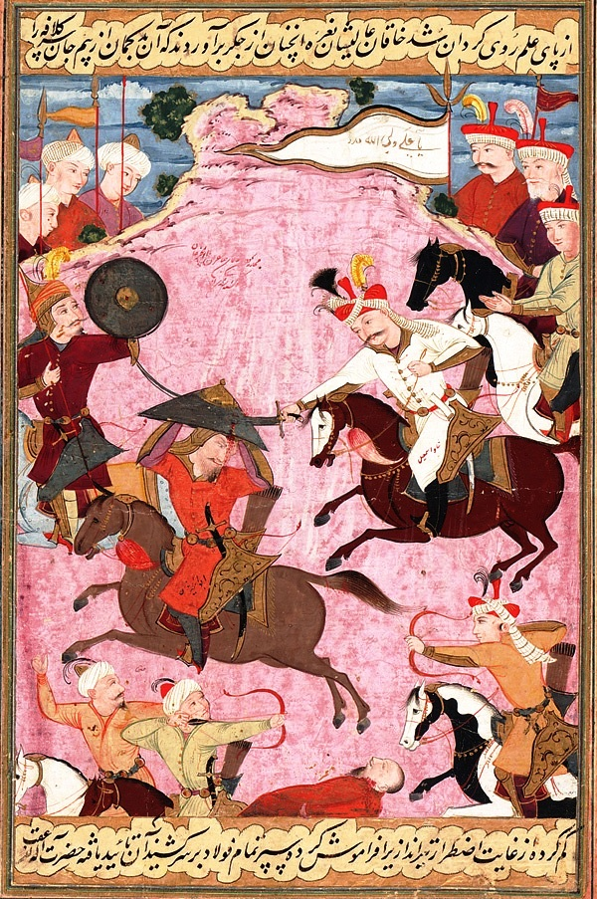
Notes:
Ismail's battle with Uzbek warlord Muhammad Shaybani Khan in 1510, on a folio from the Kebir Musaver Silsilname. After the battle Ismail purportedly gilded the skull of Shaybani Khan for use as a wine goblet.
Folio from the Tarikh-i alam-aray-i Shah Ismail (The World Adorning History of Shah Ismail); The Battle between Shah Ismail and Shaybani Khan
Opaque watercolor and ink on paper
H: 23.6 W: 15.1 cm
Isfahan, Iran circa 1688
https://upload.wikimedia.org/wikipedia/commons/5/57/The_Battle_between_Shah_Ismail_and_Shaybani_Khan.jpg
By Mu'in Musavvir , (Iranian, Safavid dynasty [Public domain], via Wikimedia Commons

Slide 8
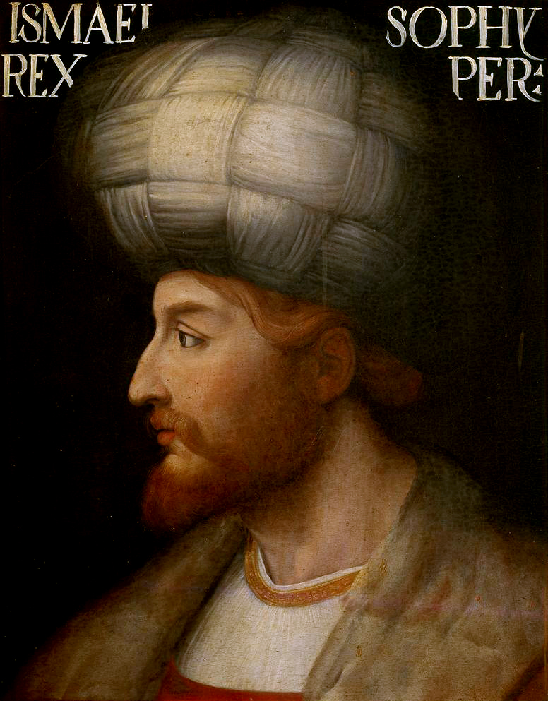
Notes:
Shah Ismail I
By unknown venetian artist (http://bss.sfsu.edu/behrooz/Safavid.htm [1]) [Public domain], via Wikimedia Commons
https://upload.wikimedia.org/wikipedia/commons/3/36/Shah_Ismail_I.jpg

Slide 9
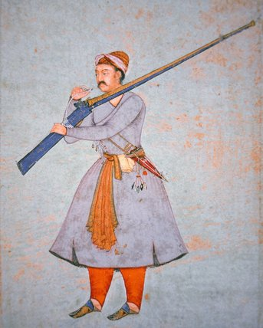
Notes:
Credit: Officer of the Mughal Army, c.1585 (colour litho), Indian School, (16th century) / Private Collection / Peter Newark Military Pictures / The Bridgeman Art Library
PNP 314579 Image number: Officer of the Mughal Army, c.1585 (colour litho) Title: Indian School, (16th century) Primary creator: Indian Nationality: Private Collection Location: Peter Newark Military Pictures Credit: colour lithograph Medium: 16th (C16th) Date:
Vertical
By Indian School, (16th century) [Public domain], via Wikimedia Commons
https://upload.wikimedia.org/wikipedia/commons/0/04/Officer_of_the_Mughal_Army%2C_c.1585_%28colour_litho%29.jpg

Slide 10
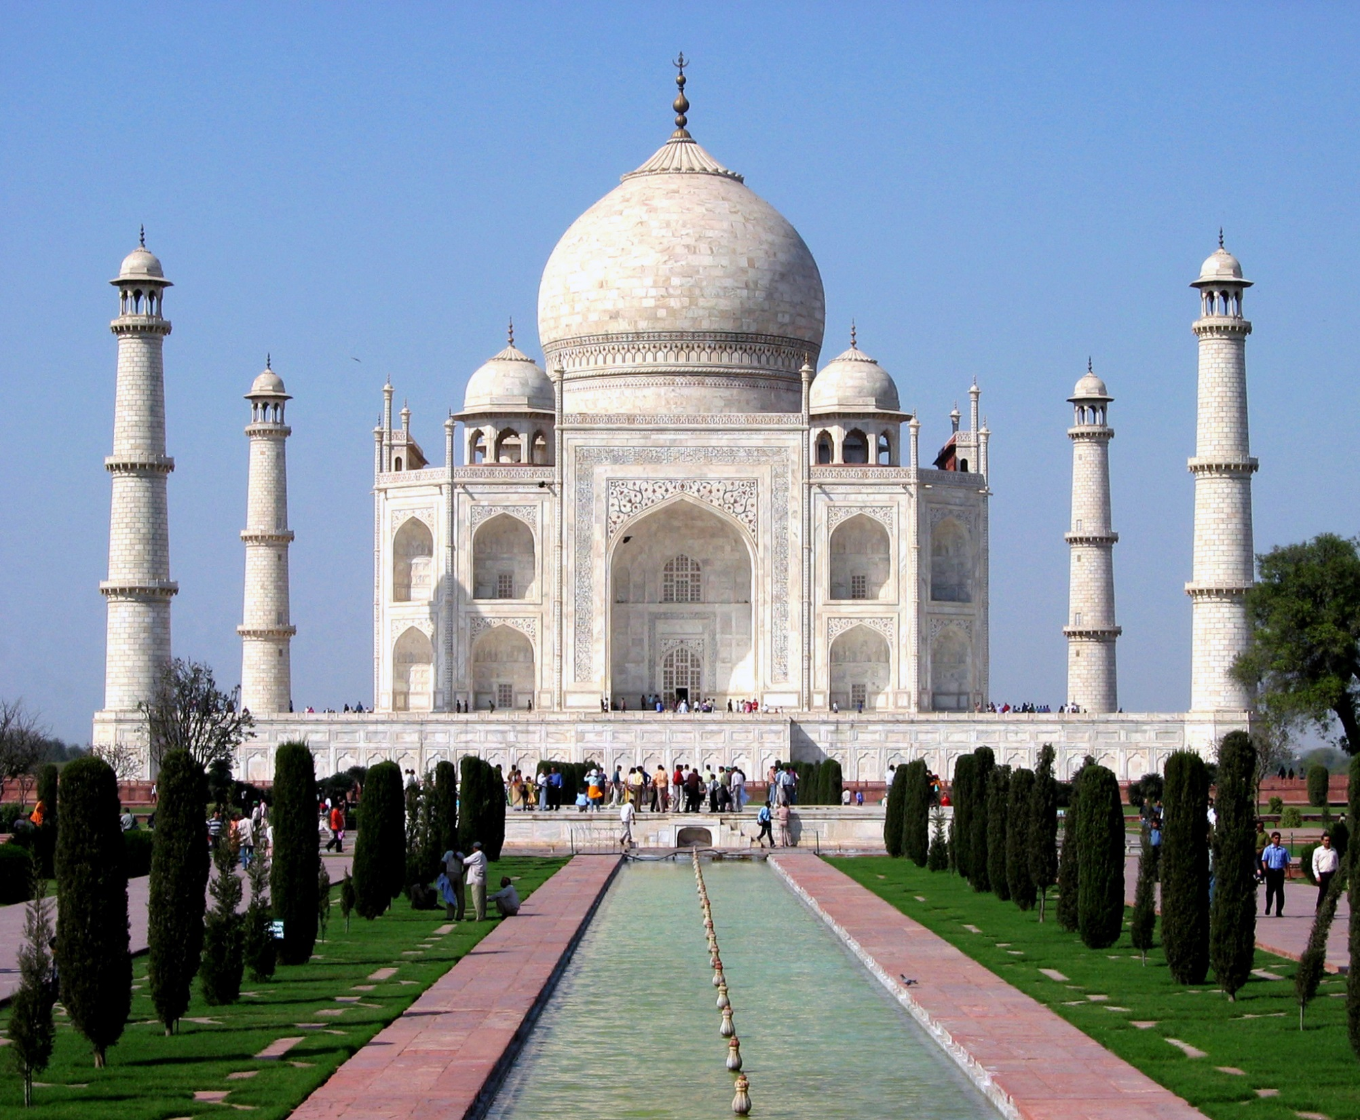
Notes:
Built by Mughal emperor Shah Jahan for his beloved wife, the Taj Mahal is a world-renowned testament to Mughal architecture.
Dhirad [GFDL (http://www.gnu.org/copyleft/fdl.html), CC-BY-SA-3.0 (http://creativecommons.org/licenses/by-sa/3.0/) or CC BY-SA 2.0 (http://creativecommons.org/licenses/by-sa/2.0)], via Wikimedia Commons
https://upload.wikimedia.org/wikipedia/commons/c/c8/Taj_Mahal_in_March_2004.jpg

Slide 11
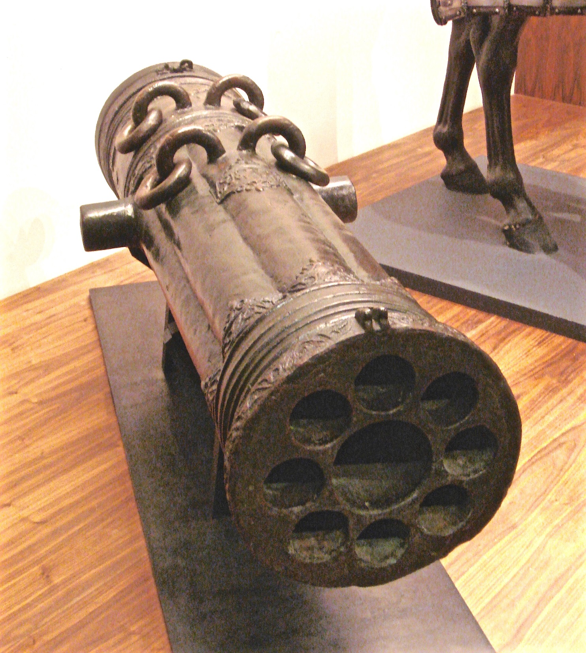
Notes:
Ottoman Empire volley gun with 9 barrels, early 16th century
By PHGCOM [Public domain], via Wikimedia Commons
https://upload.wikimedia.org/wikipedia/commons/f/f6/Early_16th_century_Ottoman_volley_gun.jpg

Slide 12
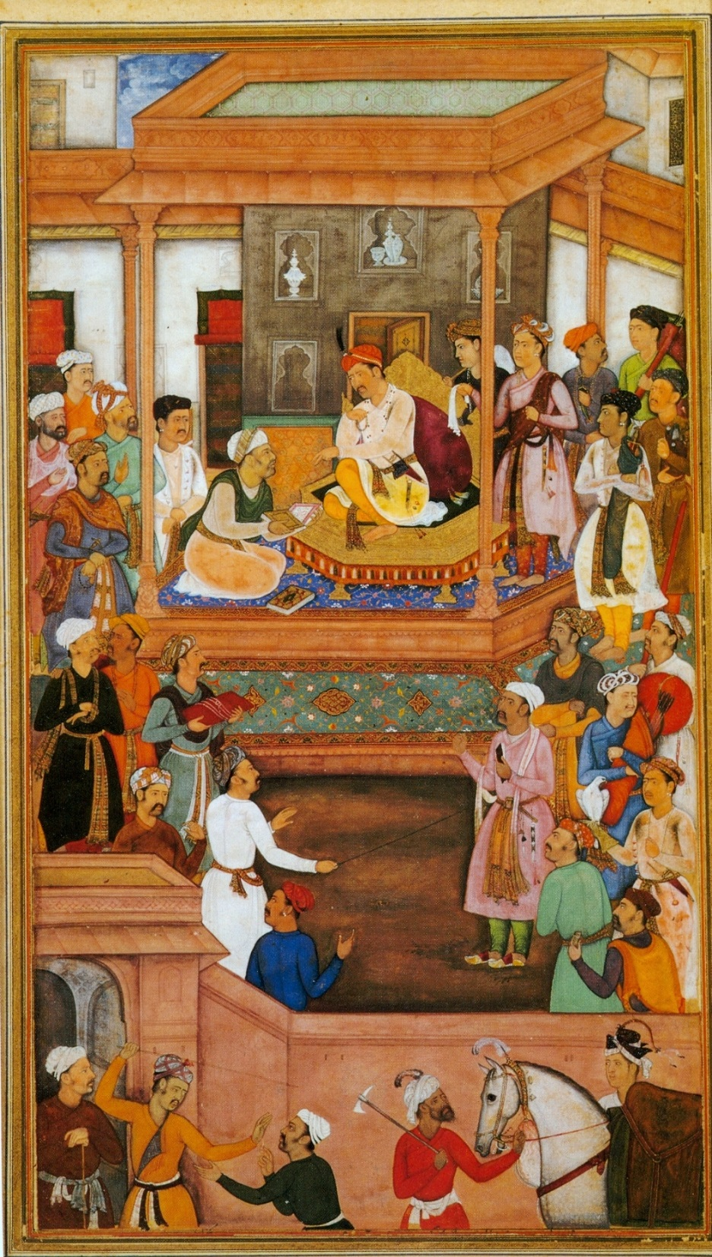
Notes:
Abu'l-Fazl ibn Mubarak presenting Akbarnama to the Grand Mogul Akbar. Mughal miniature.
By Евгений Ардаев at ru.wikipedia [Public domain], from Wikimedia Commons
https://upload.wikimedia.org/wikipedia/commons/f/f1/AbulFazlPresentingAkbarnama.jpg

Slide 13
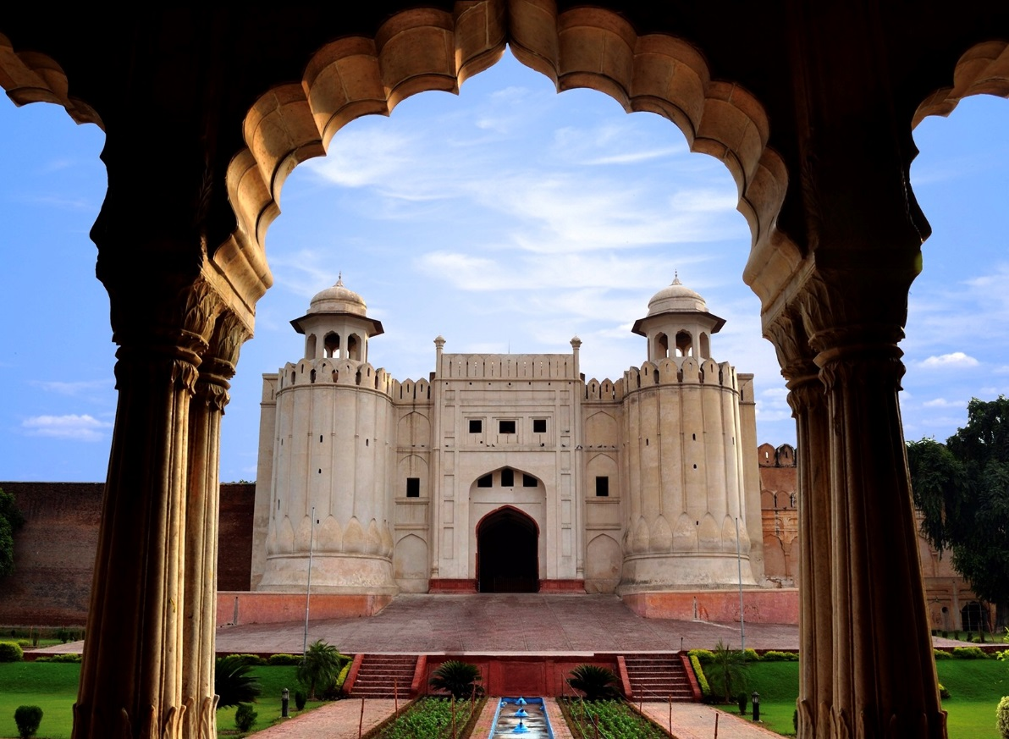
Notes:
Lahore Fort complex (including Moti Masjid, Naulakha Pavilion, Sheesh Mahal and others)
By Rohaan Bhatti (Own work) [CC BY-SA 3.0 (http://creativecommons.org/licenses/by-sa/3.0)], via Wikimedia Commons
https://upload.wikimedia.org/wikipedia/commons/4/4f/Lahore_Fort_view_from_Baradari.jpg

Slide 14
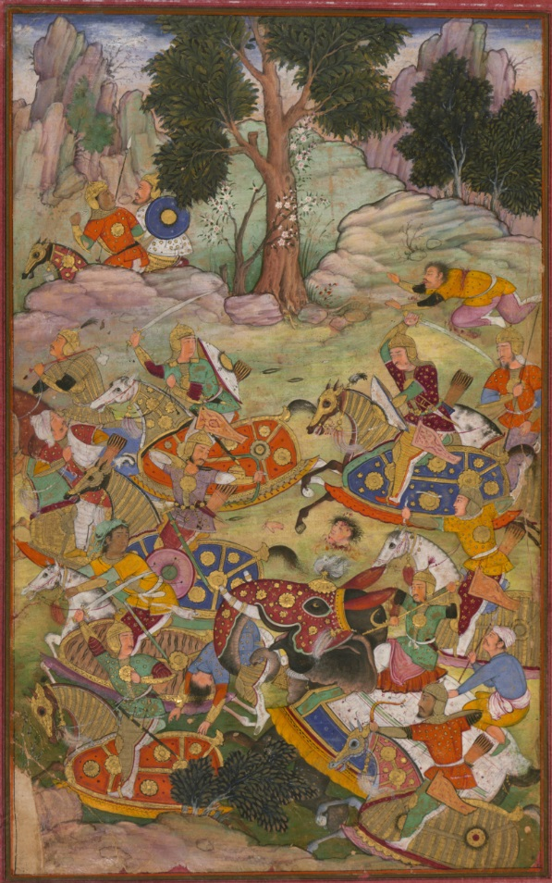
Notes:
Illustrations from the Manuscript of Baburnama (Memoirs of Babur) - Late 16th Century
Bāburnāma is the memoirs of Ẓahīr ud-Dīn Muḥammad Bābur (1483-1530), founder of the Mughal Empire and a great-great-great-grandson of Timur. It is an autobiographical work, originally written in the Chagatai language, known to Babur as "Turki" (meaning Turkic), the spoken language of the Andijan-Timurids. Because of Babur's cultural origin, his prose is highly Persianized in its sentence structure, morphology, and vocabulary,and also contains many phrases and smaller poems in Persian. During Emperor Akbar's reign, the work was completely translated to Persian by a Mughal courtier, Abdul Rahīm, in AH (Hijri) 998 (1589-90).
These Paintings, being a fragment of a dispersed copy, was executed most probably in the late 10th AH /16th CE century. It contains 30 mostly full-page miniatures in fine Mughal style by at least two different artists. Another major fragment of this work (57 folios) is in the State Museum of Eastern Cultures, Moscow.
By Ẓahīr ud-Dīn Muḥammad Bābur (1483-1530) It contains 30 mostly full-page miniatures in fine Mughal style by at least two different artists. [Public domain], via Wikimedia Commons
https://upload.wikimedia.org/wikipedia/commons/3/37/The_battle_of_Panipat_and_the_death_of_Sultan_Ibr%C4%81h%C4%ABm%2C_the_last_of_the_L%C5%8Dd%C4%AB_Sultans_of_Delhi.jpg

