Slide 1
World History Unit 5 Source Set: The Middle Ages
Charlemagne, Manorial System, Peasants.

Slide 2
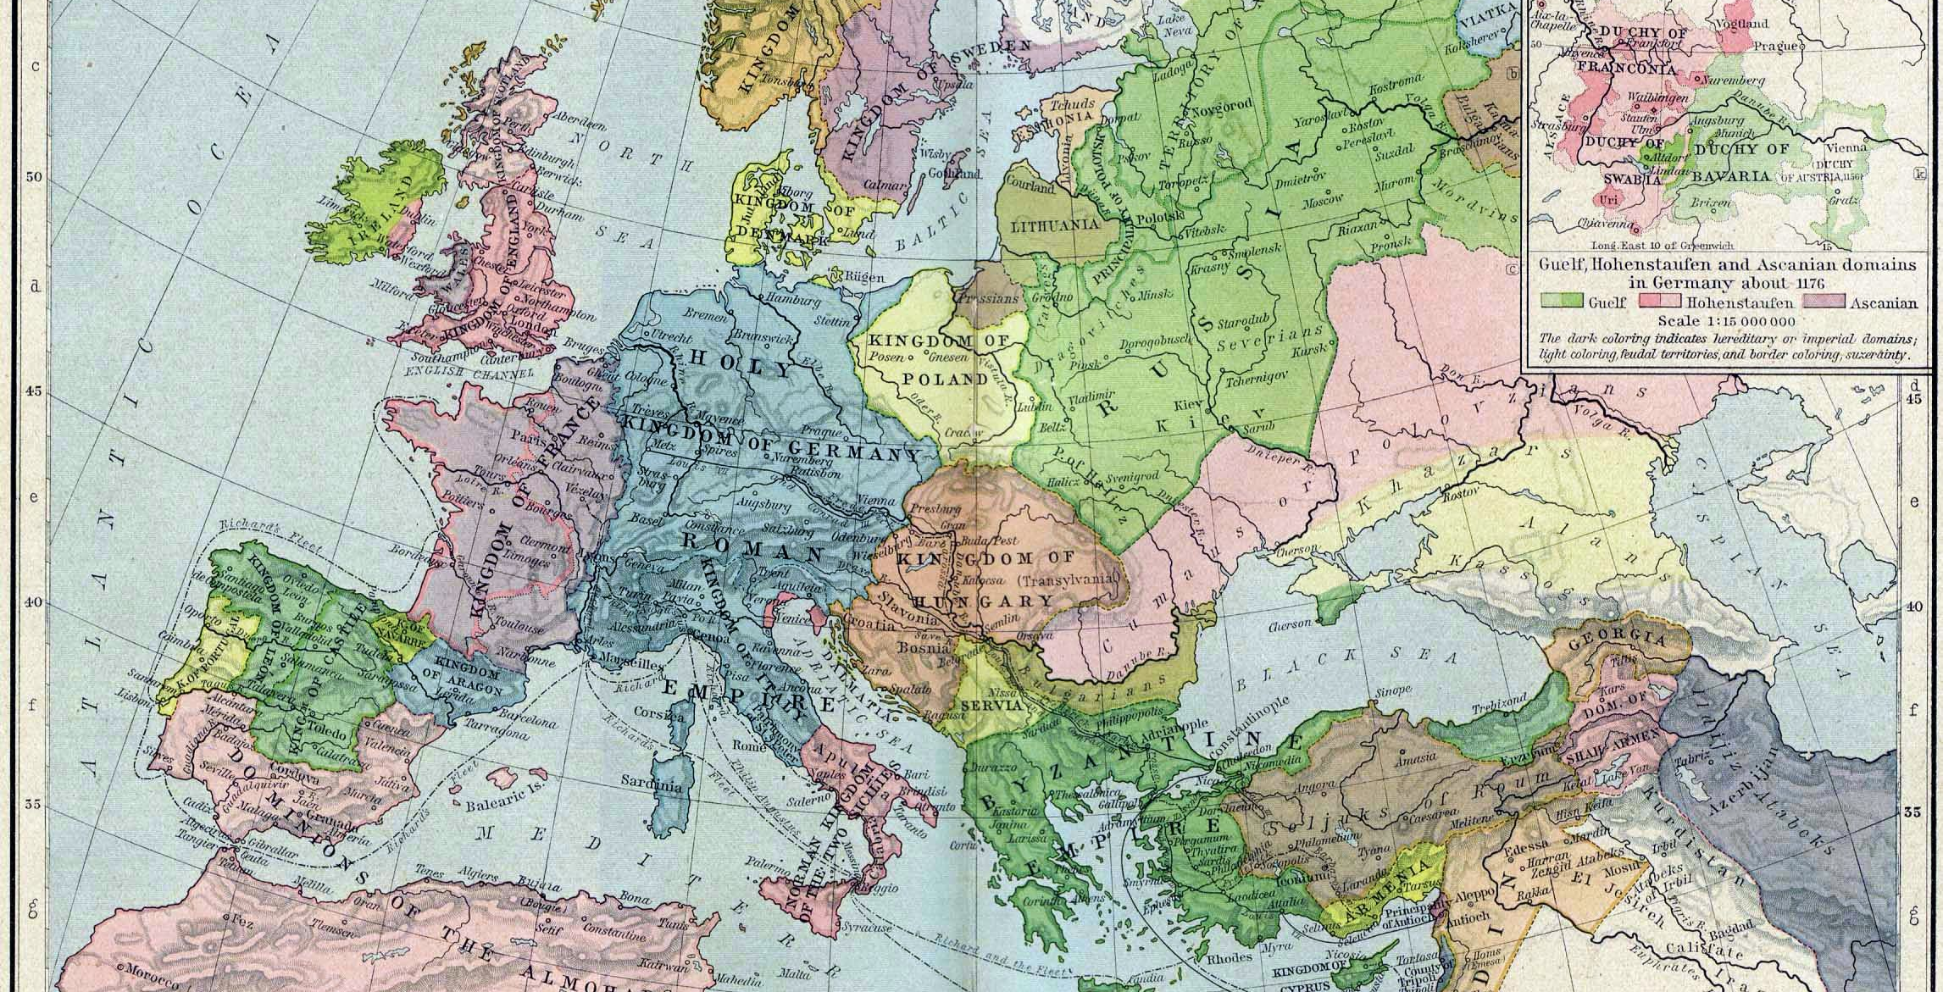
Notes:
https://upload.wikimedia.org/wikipedia/commons/7/75/Europe_mediterranean_1190.jpg

Slide 3
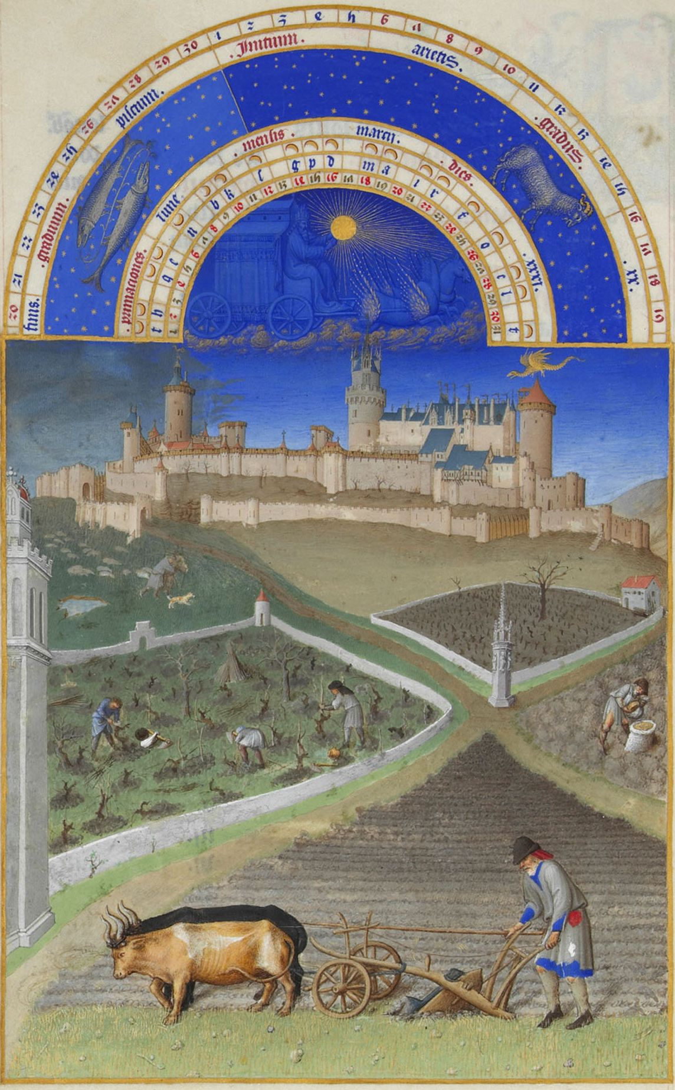
Notes:
https://upload.wikimedia.org/wikipedia/commons/7/7a/Les_Tr%C3%A8s_Riches_Heures_du_duc_de_Berry_mars.jpg
In the foreground, a farmer plowing a field with a plow pulled by two oxen, the man directing them with a long pole. The vineyards cut the vineyard in an enclosure on the left and plow the soil with a hoe to aerate the soil: these are the first ways of the vine. On the right, a man leans over a bag, probably to draw seeds that he will then sow. Finally, at the bottom, a shepherd takes the dog which keeps his flock. In the background is the castle of Lusignan (Poitou), property of the Duke of Berry which made it modernize. On the right of the image above the Poitevin tower is a winged dragon representing the fairy Melusine.

Slide 4
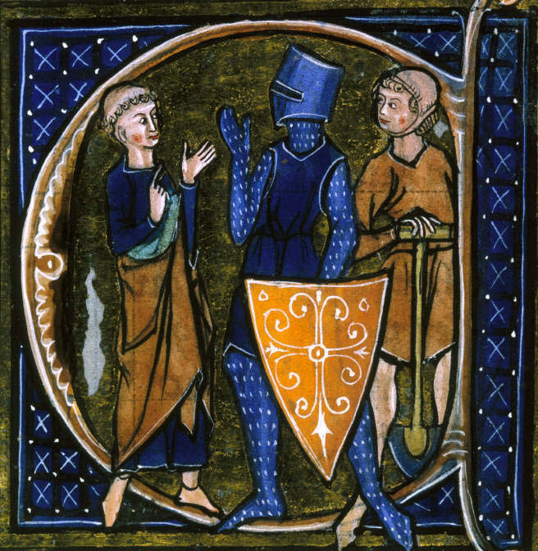
Notes:
https://upload.wikimedia.org/wikipedia/commons/c/cd/Cleric-Knight-Workman.jpg
An inhabited initial from a 13th-century French text representing the tripartite social order of the Middle Ages: the ōrātōrēs (those who pray – clerics), bellātōrēs (those who fight – knights, that is, the nobility), and labōrātōrēs (those who work – peasants and members of the lower middle class).

Slide 5
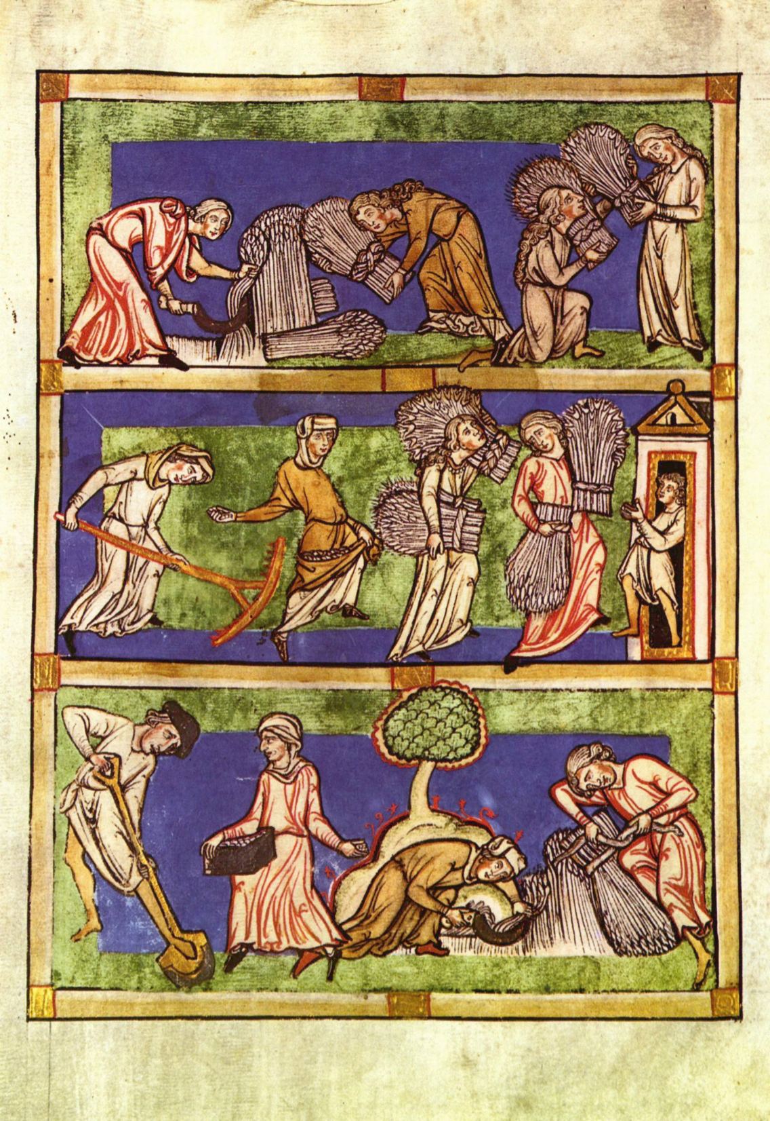
Notes:
https://upload.wikimedia.org/wikipedia/commons/5/52/Mittelrheinischer_Meister_des_13._Jahrhunderts_001.jpg
Fragment (single leaf) of a Speculum Viriginum ms., late 13th or early 14th century, Rheinisches Landesmuseum No. 15326, illustration showing the "Three Conditions of Woman", viz. virgins, widows and married wives, in a harvest allegory; the virgins reap hundredfold, the widows sixtyfold, the wives thirtyfold.

Slide 6
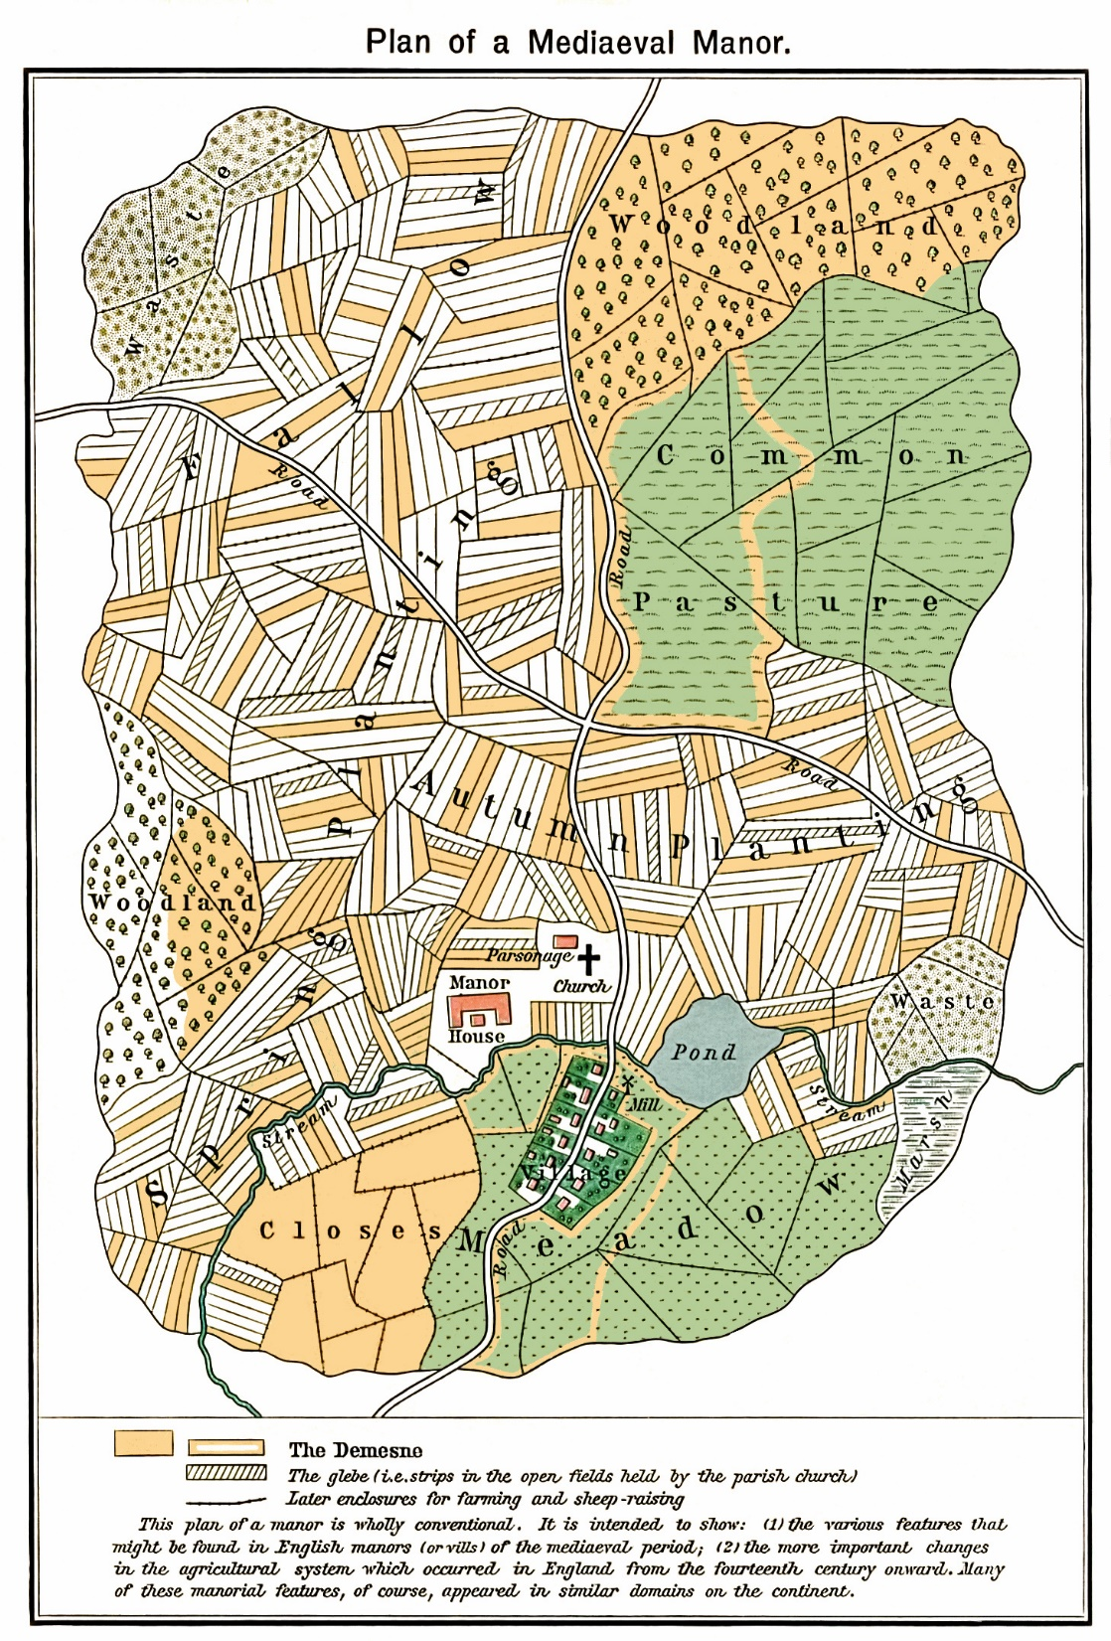
Notes:
https://upload.wikimedia.org/wikipedia/commons/6/6b/Plan_mediaeval_manor.jpg
Plan of a fictional mediaeval manor The mustard-colored areas are part of the demesne, the hatched areas part of the glebe.

Slide 7
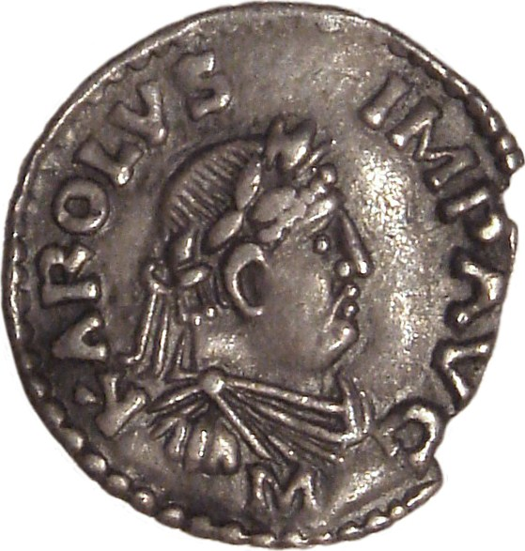
Notes:
https://upload.wikimedia.org/wikipedia/commons/f/fb/Charlemagne_denier_Mayence_812_814.jpg
Obverse of a Charlemagne denier coined in en:Frankfurt from 812 to 814, today at the en:Cabinet des Médailles in Paris.
A denarius of Charlemagne dated c. 812–814 with the inscription KAROLVS IMP AVG (Karolus Imperator Augustus) (Latin)

Slide 8
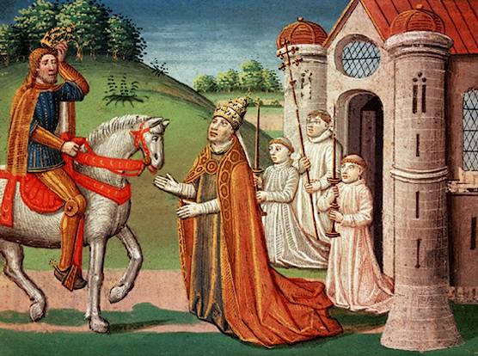
Notes:
https://upload.wikimedia.org/wikipedia/commons/d/d6/Charlemagne_and_Pope_Adrian_I.jpg
"Charlemagne and the Pope". The Frankish king Charlemagne was a devout Catholic who maintained a close relationship with the papacy throughout his life. In 772, when Pope Adrian I was threatened by invaders, the king rushed to Rome to provide assistance. Shown here, the pope asks Charlemagne for help at a meeting near Rome.

