Slide 1
World History Unit 6 Source Set: The TransAtlantic Slave Trade

Slide 2
Map 1: Overview of the slave trade out of Africa, 1500-1900
Notes:
http://www.slavevoyages.org/assessment/intro-maps

Slide 3
Slave Trade Estimates 1501-1866
Notes:
http://www.slavevoyages.org/assessment/estimates

Slide 4
Notes:
John Newton
John Newton of Liverpool, an eighteenth-century captain of English slave ships, was active in the African trade until bad health forced him to abandon this career. He taught himself Latin while still captaining slavers. The future vicar of Saint Mary's Woolroth, Captain Newton wrote the hymn "Amazing Grace.“
John Newton. Digital image. In Motion. N.p., n.d. Web. 13 May 2017. <http://www.inmotionaame.org/gallery/detail.cfm?migration=1&topic=99&id=255734&type=image&metadata=show&page=2>.

Slide 5
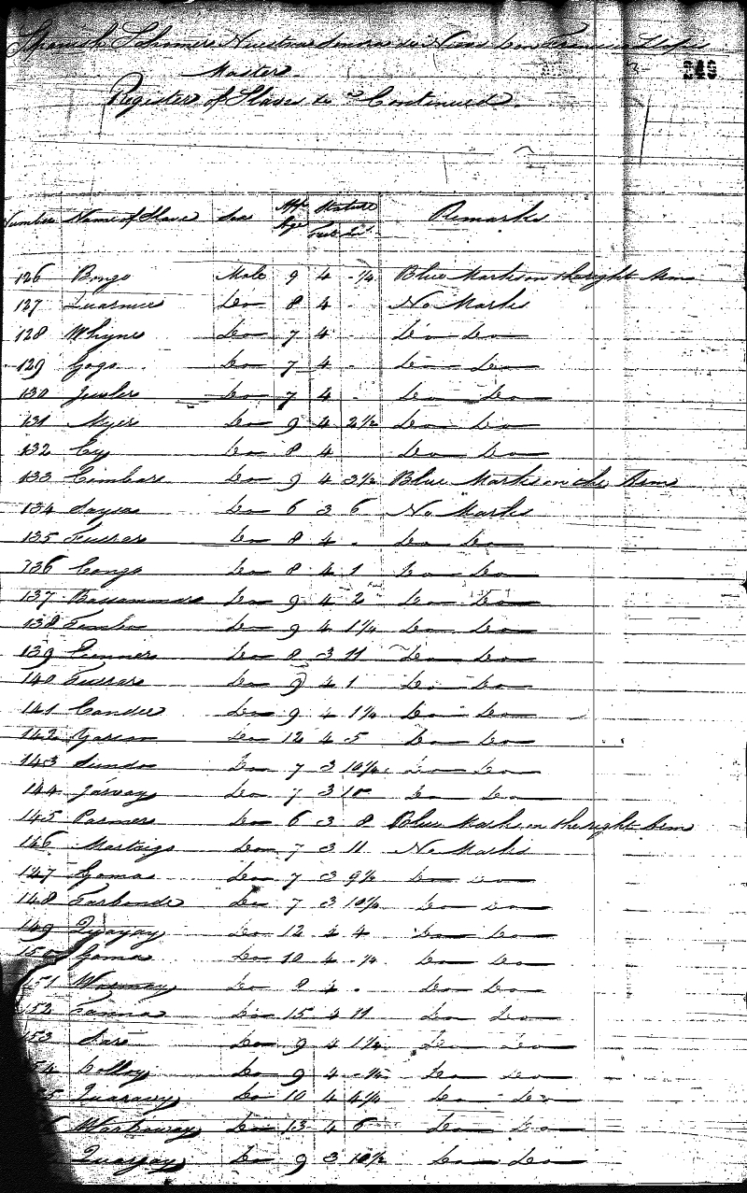
Notes:
Register of Africans from the Schooner ""NS de Regla""
The Schooner ""NS de Regla"" was captured at sea by British cruisers and adjudicated at a court established at Sierra Leone under international anti-slave trade treaties. The image is of a picture of the first page of the court’s register of ""Liberated Africans"" taken from the ""NS de Regla"". The register was kept as a formal record of emancipation that helped protect the individual from subsequent re-enslavement. The image is reproduced courtesy of the British National Archives.
Register of Africans from the Schooner ""NS De Regla"". Digital image. Slave Voyages. N.p., n.d. Web.

Slide 6
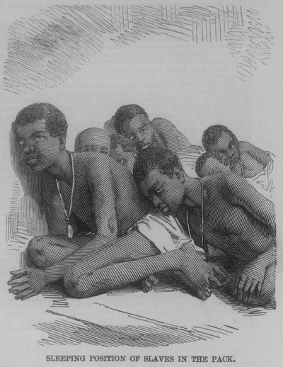
Notes:
Slaves Liberated from Slaver ""Zeldina"", Jamaica
This is one image of a group of illustrations published in The Illustrated London News on June 20th, 1857. The illustrations were created by the newspaper based on images sent with a letter from Kingston, Jamaica, dated May 11th, 1857, describing the capture of slaver ""Zeldina"" and the conditions of the slaves disembarked. The schooner ""Zeldina"" embarked slaves at Cabinda, but she was blown off her route to Cuba, captured by the British naval force in April, 1857, and stationed at Port Royal, Jamaica. The image is reproduced courtesy of the Manuscript, Archives and Rare Book Library, Emory University.
Slaves Liberated from Slaver ""Zeldina"", Jamaica. Digital image. Voyages. N.p., n.d. Web. 13 May 2017. <http://www.slavevoyages.org/resources/images/category/Slaves/2>.

Slide 7
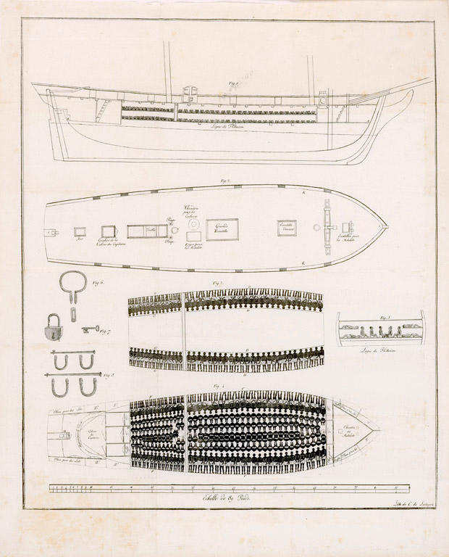
Notes:
The Brig “Vigilante” was a French slaver captured in the River Bonny, at the Bight of Biafra, on April 15th, 1822. She departed from Nantes, in France, and carried 345 slaves from the coast of Africa, but she was intercepted by anti-slave trade cruisers before sailing to the Americas and taken to Freetown, Sierra Leone. The English had no rights to detain vessels under the French flag, and the cruiser had approached the “Vigilante” only in order to verify its papers. The French captain, fearing detention, opened fire killing several of the cruiser’s crew. It was only then that the “Vigilante” was taken captive and escorted to first Sierra Leone where the slaves were disembarked, and then to Plymouth, England, where the English captain hoped to lay murder charges. Abolitionists drew the vessel while it was in Plymouth. In the event, the vessel and crew were released without charges. The image is of a plan of the “Vigilante”, showing the slave decks and the instruments used to chain the slaves. This plan was published as a fold out in a pamphlet printed first in London and then Paris and other places in 1823. The image is reproduced courtesy of the John Carter Brown Library at Brown University.
Year: 1822
Source:
Affaire de la Vigilante, batiment négrier de Nantes (Paris, 1823), following p. 8
Language:
French
Plan of the Slaver ""Vigilante"". Digital image. Voyages. N.p., n.d. Web. 13 May 2017. <http://www.slavevoyages.org/resources/images/category/Vessels/1>.

Slide 8
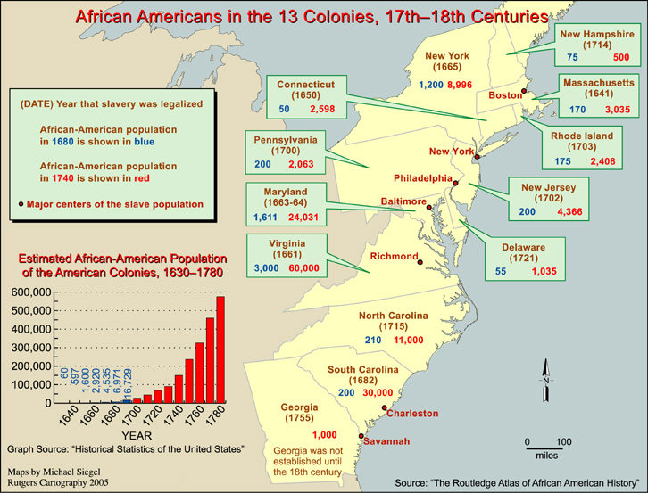
Notes:
African Americans in the 13 Colonies, 17th-18th Centuries. Digital image. In Motion. N.p., n.d. Web. <http://www.inmotionaame.org/gallery/detail.cfm?migration=1&topic=1&id=1_005M&type=map>.

Slide 9
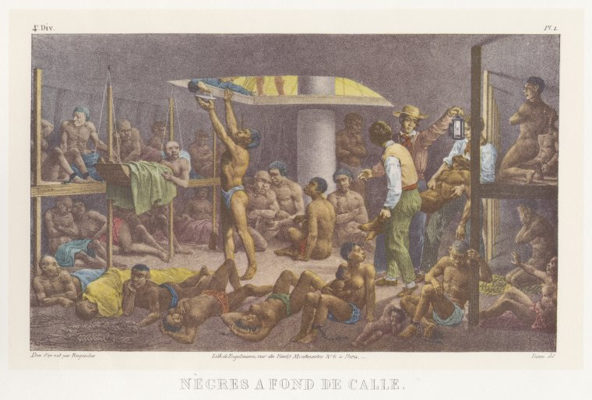
Notes:
Nègres à Fond de Cale
The slave ship viewed by a survivor:
"Its horrors, ah! who can describe? None can so truly depict its horrors as the poor unfortunate, miserable wretch that has been confined within its portals. Oh! friends of humanity, pity the poor African, who has been trepanned and sold away from friends and home, and consigned to the hold of a slave ship, to await even more horrors and miseries in a distant land, amongst the religious and benevolent."
Mahommah Gardo Baquaqua, Biography of Mahommah G. Baquaqua (Detroit: Geo. E. Pomeroy & Co., 1854)
Nègres à Fond De Cale. Digital image. In Motion. N.p., n.d. Web. <http://www.inmotionaame.org/gallery/detail.cfm?migration=1&topic=5&id=299670&type=image&metadata=show&page=>.

Slide 10
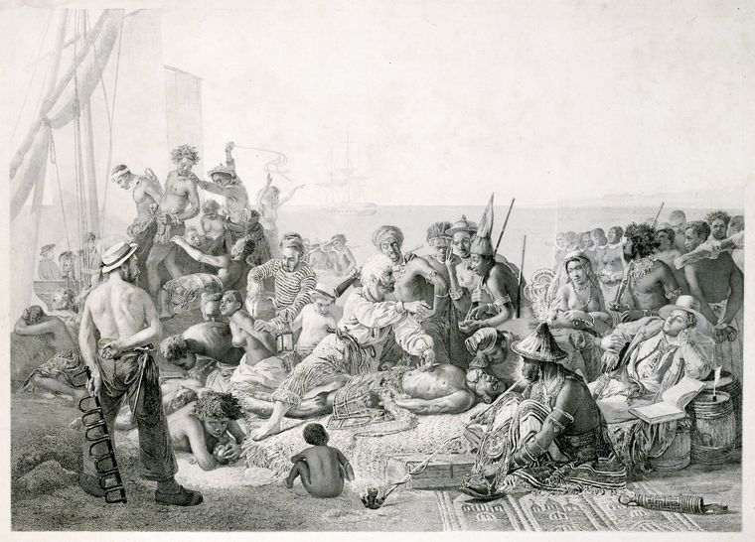
Notes:
Bartering for Slaves on the Gold Coast
Many men, women, and children died on the way to the coast before the European slavers made their selection. Others died at the port of departure, usually as a result of exposure to new diseases or the appalling conditions in the barracoons, or slave camps.
Biard, Francois. Bartering for Slaves on the Gold Coast. Digital image. In Motion. N.p., n.d. Web. 13 May 2017. <http://www.inmotionaame.org/gallery/detail.cfm?migration=1&topic=4&id=298001&type=image&metadata=show&page=>.

Slide 11
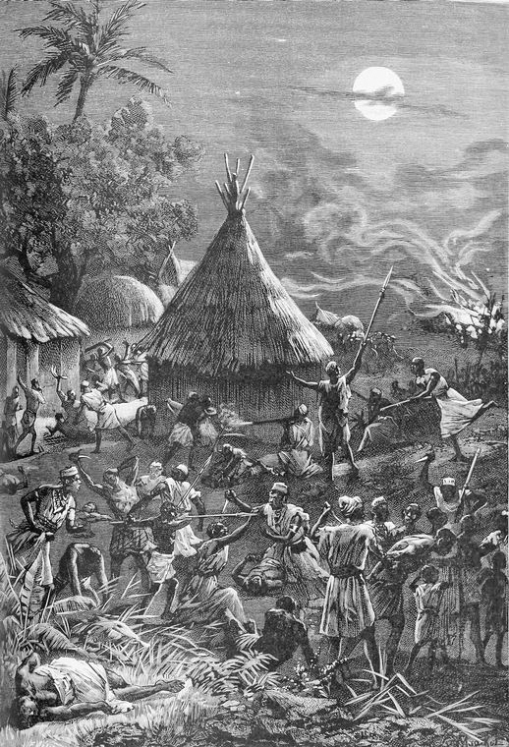
Notes:
Raid on a Village
The slave raids resulted in social and economic devastation. As children and young adults were taken away, infants and the elderly were left behind or killed. Entire communities had to relocate in difficult, hard-to-reach terrain, leading to stagnation or even regression.
Attaque D'un Village Par Les Esclavagistes. Digital image. In Motion. N.p., n.d. Web. 13 May 2017. <http://www.inmotionaame.org/gallery/detail.cfm?migration=1&topic=9&id=292493&type=image&metadata=&page=>.

